Slide 1
Help During the Energy Crisis
Mick Blakeley
Service Delivery Manager
Mick.Blakeley@caliverpool.org.uk

Slide 2
Background to the Energy Crisis
There are a number of factors that have contributed to the rise in energy costs, including.
The war in Ukraine
The Covid 19 pandemic
Climate change
Energy companies going out of business
This led to a drastic rise in the Government’s energy cap.

Slide 3
Energy Price Cap
Government scheme that limits the maximum unit cost that can be charged by energy companies
Started in January 2019
Raised by 12% in October 2021
Raised in April 2022 by 54%
With forecasted 80% increase in October 2022 the government introduced the Energy Price Guarantee

Slide 4
Energy Price Guarantee
This new scheme will reduce the unit cost of electricity and gas to average £2500 a year for the next 6 months
On average a household will save £1000 per year (based on October’s prices)
Energy suppliers will be fully compensated by the government for savings delivered to households.
Individual customer amount paid under the scheme will vary depending how much energy they use, where they live, how they pay for their energy and their metering arrangement.
 | Energy Price Guarantee- October 2022 How much will you pay?
Elec | £0.34 per KWH Daily standing charge £0.46
Gas | £0.10 per KWH Daily standing charge £0.28

Slide 5
What are we seeing?
CAL is at the forefront of advising clients on the energy crisis and offer a holistic service.
Residents are seeking assistance with negotiating fuel bills, challenging incorrect billing and for fuel vouchers.
126% increase in clients presenting at our services wanting advice on a fuel issue in the period April 22-October 22 compared with the same period last year.
Since April 22 issued over 750 vouchers

Slide 6
Who is it impacting?
The energy/cost of living crisis is impacting all sections of society. There is a rise in clients from all demographics contacting us for energy advice
The largest increases have been seen in:
single people both in work and in receipt of welfare benefits
Lone parents both in work and out of work
Couples with children in rented property
Pensioners

Slide 7
Energy bill discount
This is £400 off Energy Bills – non repayable universal support. Payments start in October for six months and how you receive it depends on how you pay
Direct debit - reduction on your monthly payment or a refund into your bank account from your provider
Standard credit customers – should see the credits added to their bill automatically
Smart prepayment customers –credit on meter the first week of each month
Traditional prepayment customers – not automatic, credits have to be redeemed.
This support has Not been renewed for 23/24

Slide 8
Cost of living payments
To help with cost of living increases a payment of £650 will be allocated in two instalments. This should be paid automatically to eligible claimants
Cost of living payments announced in the recent statement by the chancellor for the year 23/24 One off £900 payment. Full eligibility and timing of payment has not been released
Disabled - will receive a one-off payment of £150 if you have been in receipt of a benefit in relation to your disability. Automatic and renewed for 23/24
Pensioner - If entitled to receive a Winter Fuel Payment for 2022/23, will receive an additional payment of £300. Renewed for 23/24

Slide 9
Council Tax Energy Rebate
Help was available for households in Band A-D in the form of a rebate of £150. This money could be used to reduce Council Tax bill or be paid into client's bank account.
Clients who pay their bill by DD will have already been contacted and council have sent letters to many other households.
If client hasn't received either the money or a letter, they can apply online to either credit CT account or have money paid into their bank account
https://liverpool.gov.uk/council-tax/council-tax-energy-rebate/
This has NOT been renewed for 23/24

Slide 10
Other support payments
Warm Home Discount - the WHD scheme is being amended this year with a number of changes
Winter Fuel Payments – paid in addition to the Pension COL payment
Cold Weather Payments – begins 1st November 22
Green Home Grant – aims to make your home warmer and work completed by March 23

Slide 11
Help from Energy Providers
Worth checking with client's energy provider to see what extra help they may provide.
First point could be the Charis website which administrates funds and grants from numerous companies, authorities and charities including many energy companies - www.charisgrants.com
British Gas - they have an Energy Trust Fund not just open to their own customers linked in with receiving Money Advice https://britishgasenergytrust.org.uk/who-can-apply/

Slide 12
Negotiating with Energy Companies
If someone is in arrears for their energy use the first thing to do is contact their supplier to negotiate
When negotiating the supplier should look arrears and ongoing usage
Their first priority should be to ensure you are managing to pay your ongoing usage then to look at an affordable arrangement to clear your arrears
Challenge them on how they have come up with usage figures.
Remember there are a number of schemes and funds to help people deal with their arrears, but paying ongoing usage is at the centre of these schemes

Slide 13
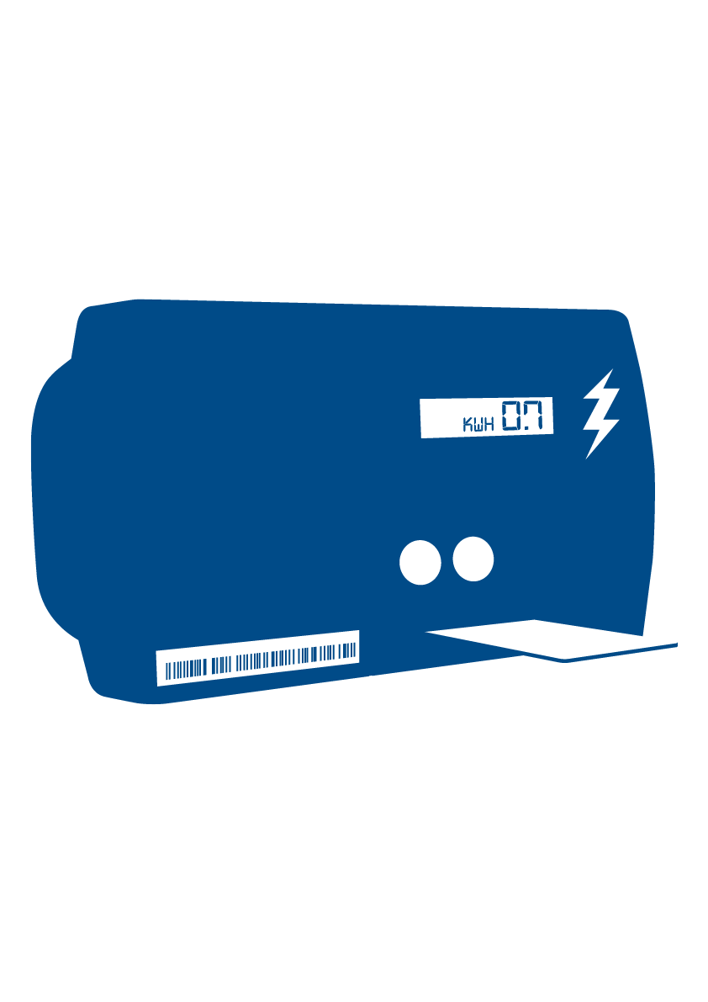
Social Policy
Citizens Advice campaign for change. We are currently campaigning and gathering evidence on:
Smart Meters being remotely switched to pre-payment from credit meters
Standing charges accumulating arrears for people in the warmer months leading to a substantial debt on the meter when it starts getting colder
The general effect on those on the lowest income energy price rises have had.

Slide 14
Any questions?
Mick Blakeley
Service Delivery Manager
Mick.Blakeley@caliverpool.org.uk

