Slide 1
Guidance on how to use the LSCP booking system – in pictures

Slide 2
Further Training
Multi-Agency Safeguarding Training from the LSCP is now available
FREE OF CHARGE via the booking system within the LSCP Website
https://liverpoolscp.org.uk/scp
From the homepage select Training

Slide 3
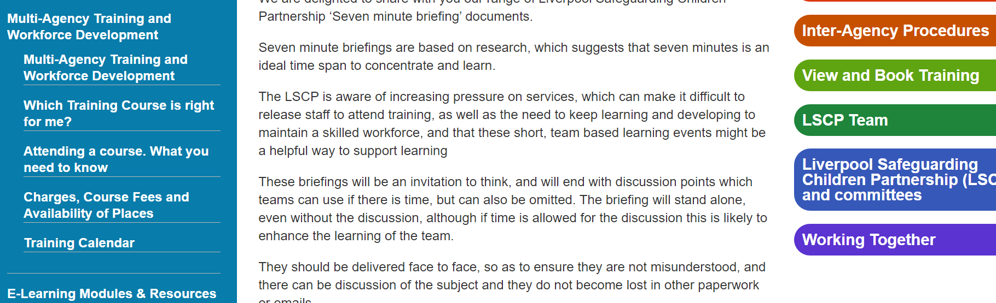
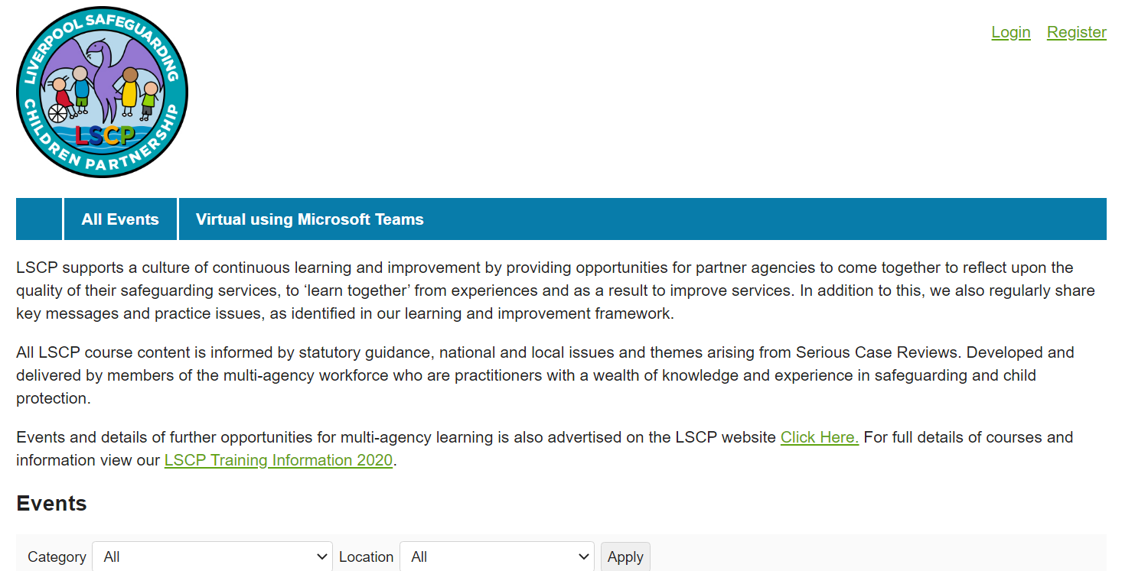
Then click on View and Book Training
Register (first time only) or Log In and search for training dates

Slide 4
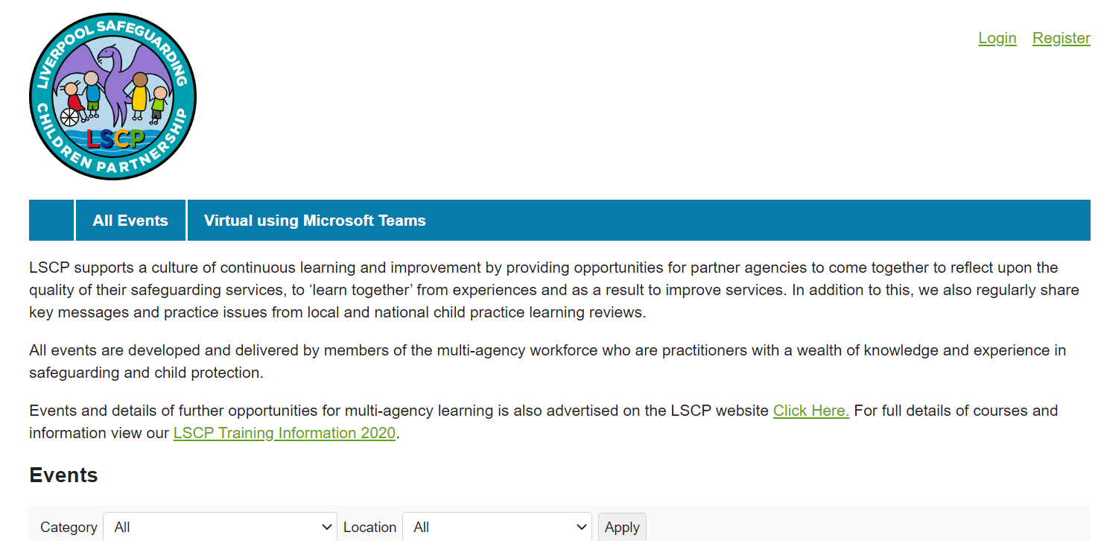
Click on Register and complete the form fields with your details. You will need to think of a memorable password for the account.

Slide 5
IMPORTANT
If you are a manager and booking staff onto courses, please ensure that all staff attending have created an account in their own name and have an email address different to the one you use. Otherwise, all correspondence and certificates will be issued in your name and NOT the attendee.
Simply adding their name to the attendee section will not work unless they have their own account.
As the manager you will be able to track who is attending and have oversight, but the certificates and evaluation forms need to be sent to them separately.
This system is an official electronic training booking system, designed for use by training organisations.
Once set up works efficiently, please do get in touch if you have any queries or questions about how it works or need some help setting up your accounts.
Thanks

Slide 6
Complete the form fields with your details.
You will need to think of a memorable password for the account

Slide 7
Once registered you can simply log into your account each time to either;
View training available and/or complete evaluations forms or to download your certificates

Slide 8
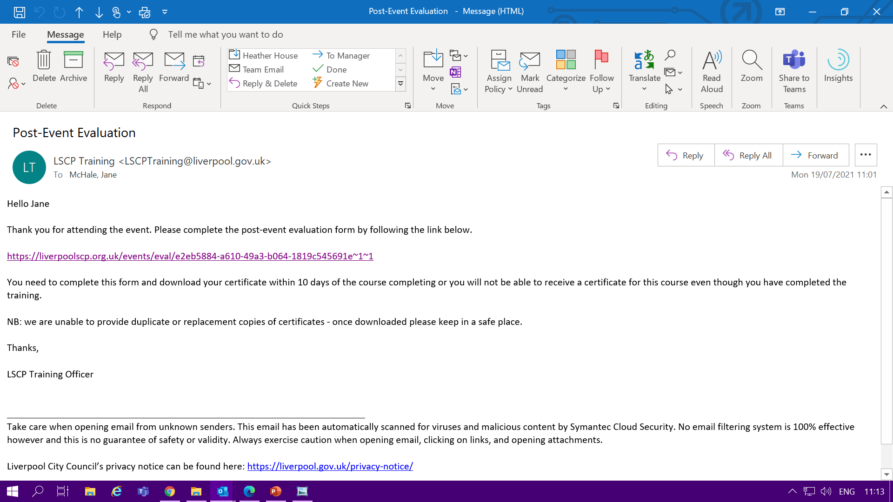
Following attendance at training Evaluation forms as sent to you automatically via an email link
NB: you will need to log into your account to complete the evaluation form

Slide 9
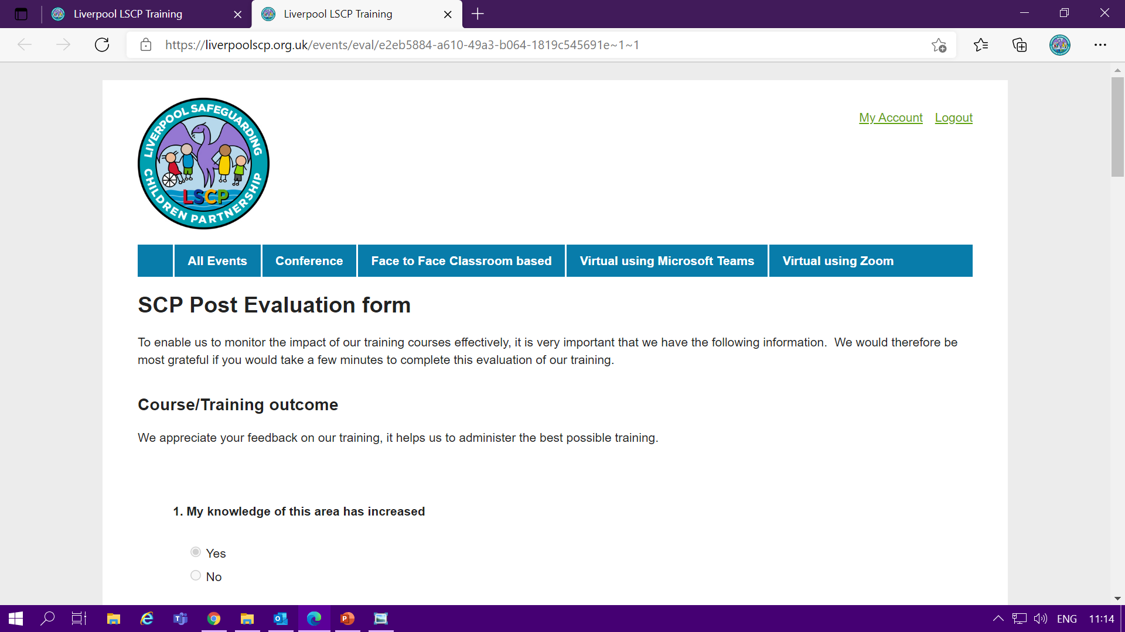
Once logged in you can see the evaluation form and simply click your responses and type and additional comments or feedback into the relevant fields

Slide 10
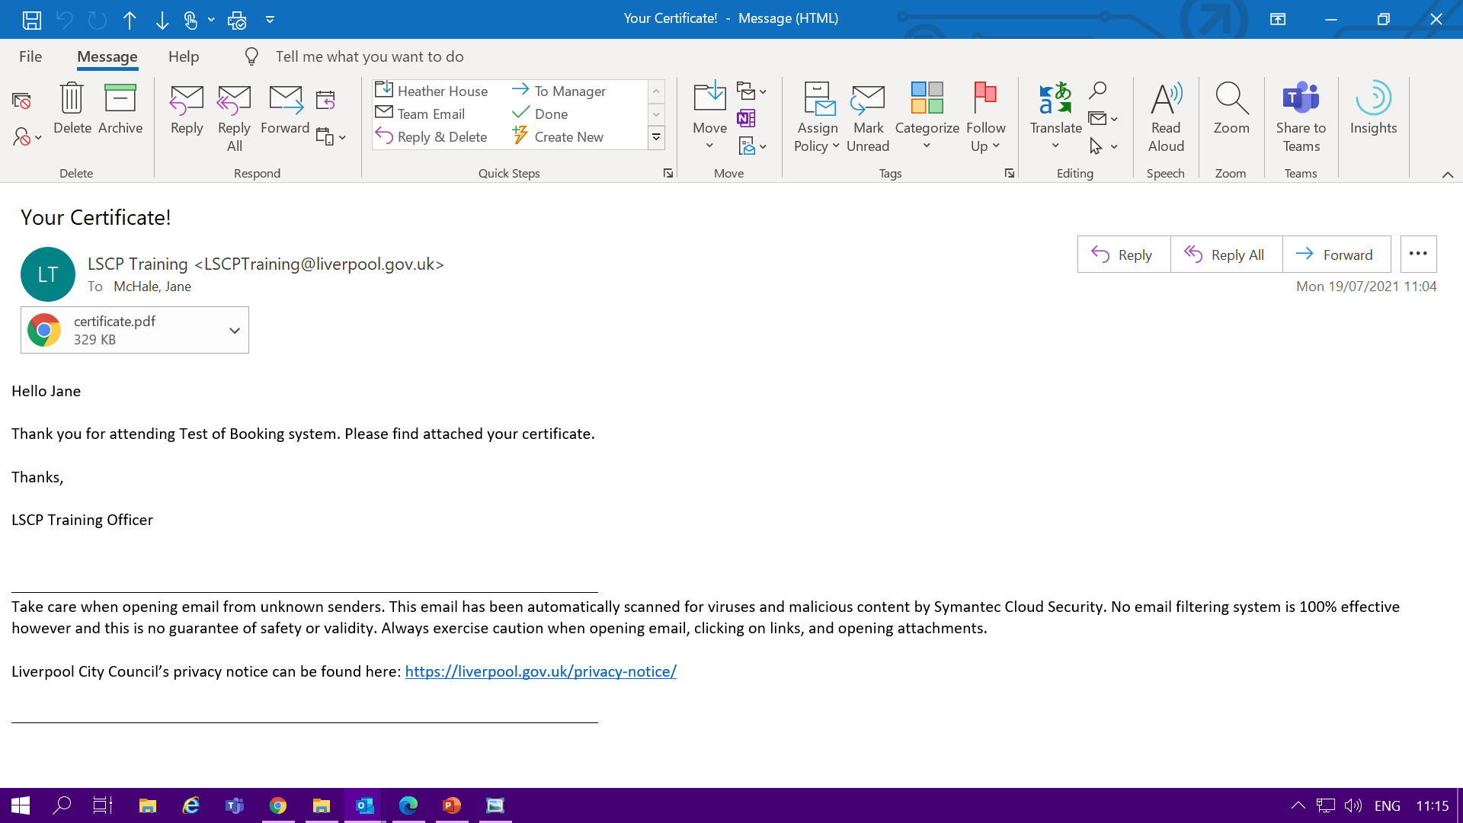
You with then automatically be sent an email with your certificate attached
PLEASE CHECK YOUR JUNK OR SPAM FOLDER AS MESSAGES DO NOT ALWAYS ARRIVE IN TO YOUR IN-BOX

Slide 11
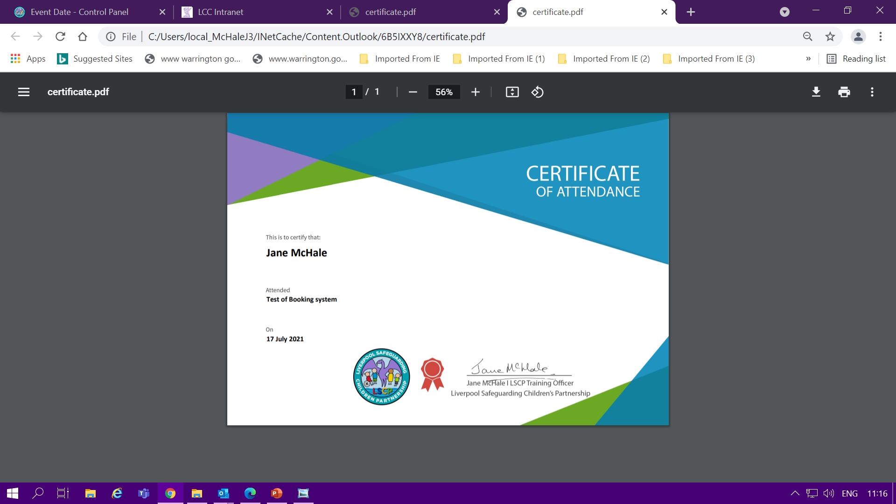
You can save and print a copy for your records

Slide 12
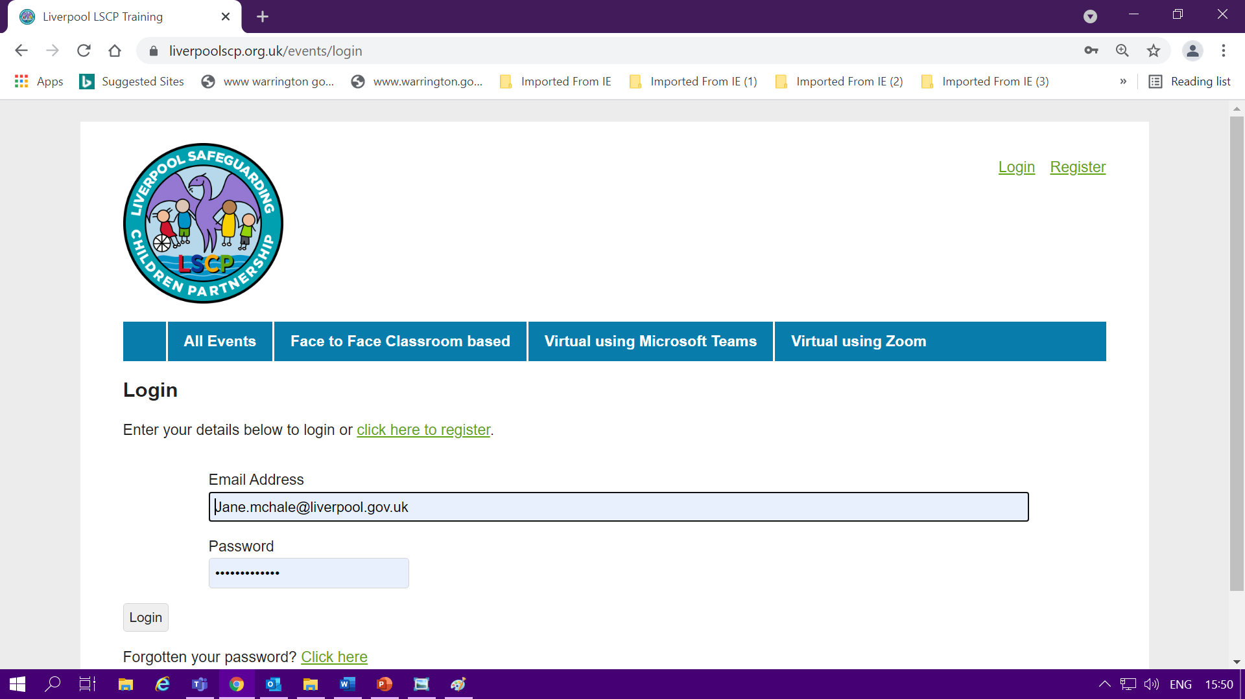
If you do not see or receive an email with an evaluation form or certificate
You can access both and view all your records within your account by logging in and viewing your account

Slide 13
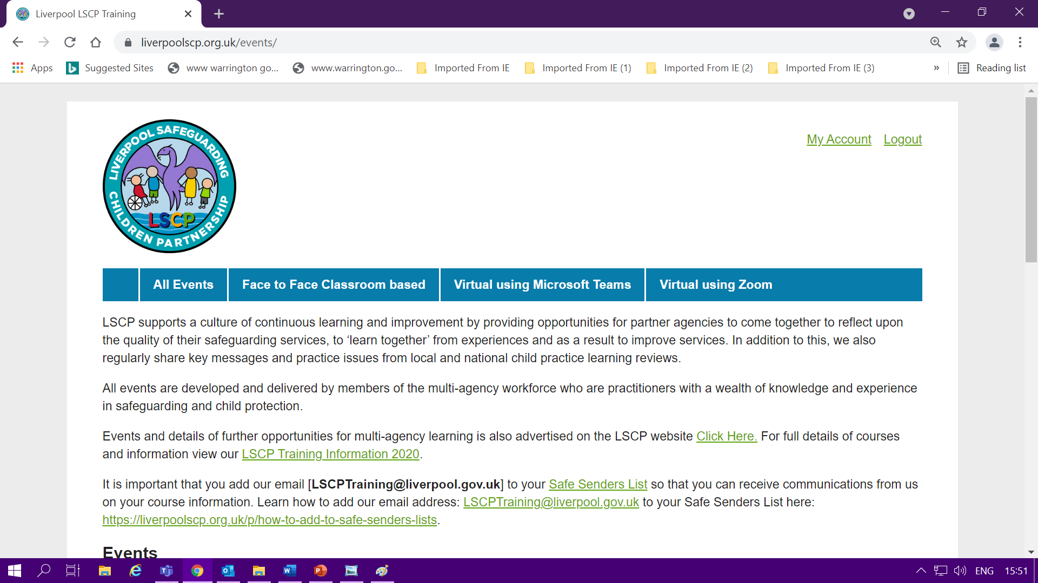
If you do not see or receive an email with an evaluation form or certificate
You can access both and view all your records within your account by logging in and viewing your account

Slide 14
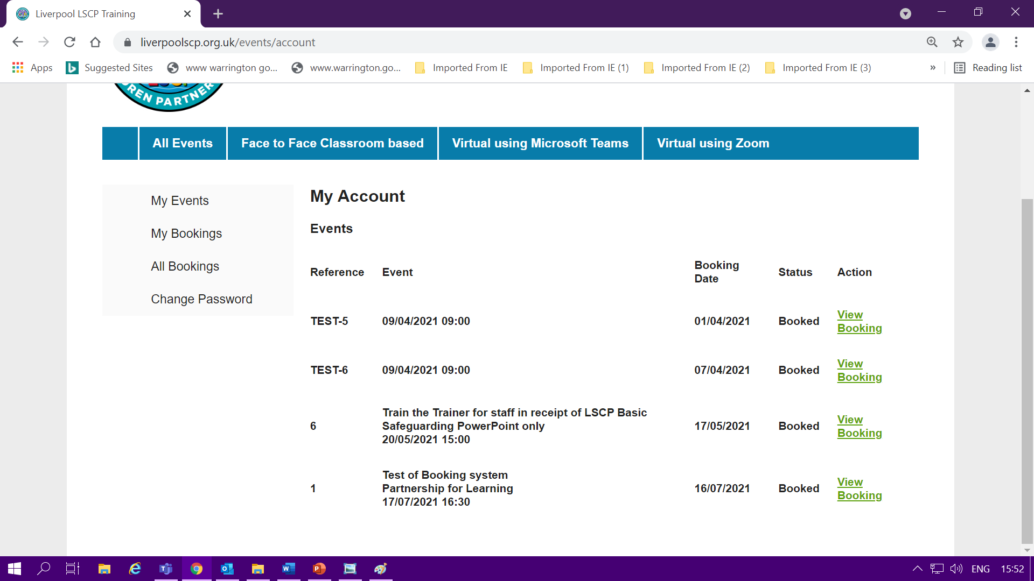
If you do not see or receive an email with an evaluation form or certificate
You can access both and view all your records within your account by logging in and viewing your account and selecting to view the course attended

Slide 15

Any queries or questions please contact us
Jane McHale
LSCP Training Officer
LSCP Training@liverpool.gov.uk

