Slide 1
Healthy Neighbours Project
‘For stronger communities’
Project Manager: Melanie Pilling
Procurement Contact: Kate Ryan
Notes:
Hello there, my name is Melanie Pilling and I work for the Torus Foundation. I’m delighted to be the Project Manager of the Healthy Neighbour Project. Here is a short video to promote our fantastic Healthy Neighbours Project opportunity

Slide 2
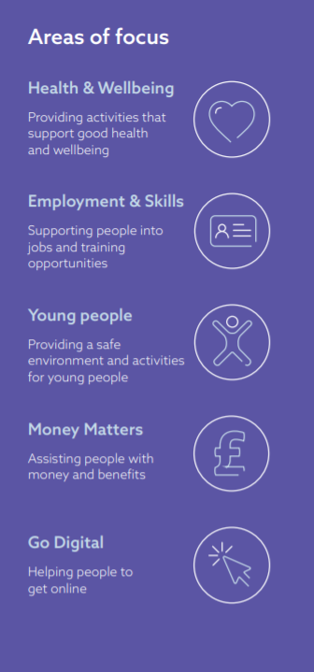
Introduction to Torus Foundation
Torus Foundation is the charitable arm of Torus, the North West’s largest affordable homes provider. Our vision is one of growing stronger communities. Places where people have access to the best life chances and opportunities to learn and earn.
The Foundation works to improve outcomes for individuals to support them to improve their health and wellbeing.
Our dedicated teams strive to make a positive difference across local Northwest communities with a focus on Torus’ three heartland areas:
Liverpool
Warrington
St Helens

Slide 3
Calling all local Organisations!!!!!!
We have an exciting NEW opportunity for local organisations to get involved in!!!
Torus Foundation plans to run 7 Healthy Neighbours projects across Liverpool, St Helens and Warrington.
Are you…..
a community-based organisation, with established social and peer networks in the local neighbourhood of the project?
able to reach all members of a community – not limited to a specific interest, age, or ethnic group?
experienced in recruiting, supporting, training and managing volunteers?
located within the ward of the target area or can establish an office/hub within the target area?

Slide 4
Where will the projects be?
St Helens | Lot 1: Parr | Lot 2: Four Acre estate
Liverpool | Lot 3: Daneville Estate | Lot 4: Granby Toxteth Triangle | Lot 7: Braybrooke estate, Norris Green
Warrington | Lot 5: Orford (Grasmere Avenue & Greenwood Crescent) | Lot 6: St Elphins Close & St Katherines Way Estate

Slide 5
Who are Healthy Neighbours?
Healthy Neighbours (community champions / volunteers) are local people tackling a social issue which is important to them and becoming agents for social change within their own community. They live and breathe their environment so know what challenges need to be addressed and how best to address them. They talk the lingo; they hear the unsaid and they can really influence change!

Slide 6
What will the Healthy Neighbours be doing?
Following an initial period of training, to be organised by the commissioned organisation, the volunteers will commence their activities of engaging local communities with the aim of improving health and wellbeing against an agreed set of health indicators.
Physical Inactivity
Mental Health
Food Poverty
Obesity
Loneliness

Slide 7
What are the expectations?
The commissioned organisation for each contract will work as part of a network commissioned by Torus Foundation to deliver the project in their area. The selected organisations will be responsible for recruiting a paid Hub Coordinator and 15-20 volunteers to implement the project over a 12 month period.
Each ‘hub’ will aim to reach around 700-800 households with their activities.
The contract will be up to the value of £45,000 per lot.

Slide 8
What is the process for bidding?
Open tender process due to be released next week with a closing date of 9th January
5 Questions
Panel who will independently score applications against criteria
Interview stage
Award the successful Organisation
If you are interested in applying for this project, then you can visit the below
web address to register your organisation
https://www.delta-esourcing.com

Slide 9
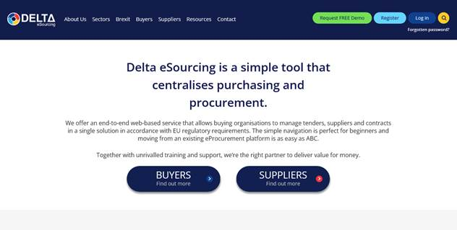
What does Delta looks like?
Notes:
Once you click the link it will open like this. If you are not already registered you can click register in the top right hand corner and select ‘register as a supplier’

Slide 10
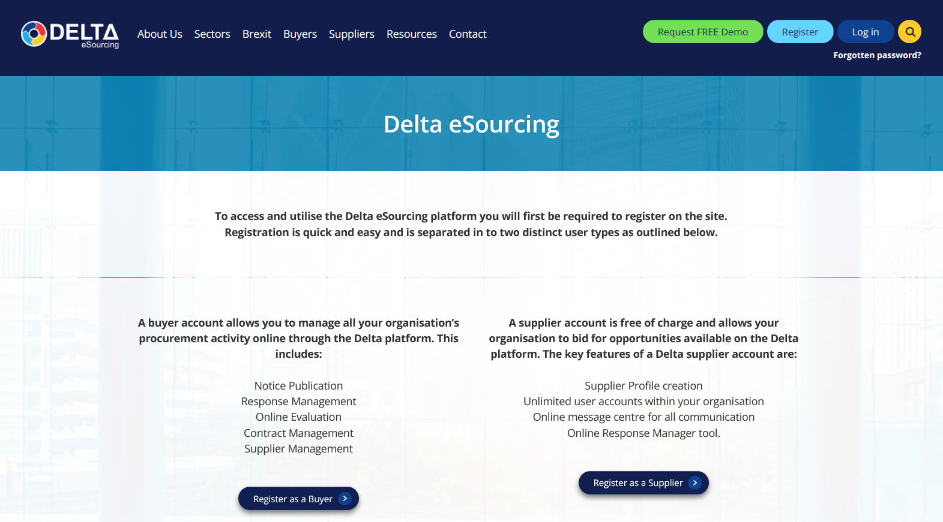
What does Delta looks like?

Slide 11
Thank you for listening
If you have any further questions before the tender goes live,
then please don’t hesitate to contact Kate Ryan.
Email: kate.ryan@torus.co.uk
For all enquiries after this date, all questions must be sent via Delta.

