Slide 2
easyfundraising means more funds

Slide 3
How it works

Slide 4
Christmas shopping = donations

Slide 6
How to set up your easyfundraising page:
Go to: www.easyfundraising.org.uk/lcvs

Slide 7
Your fundraising page

Slide 8
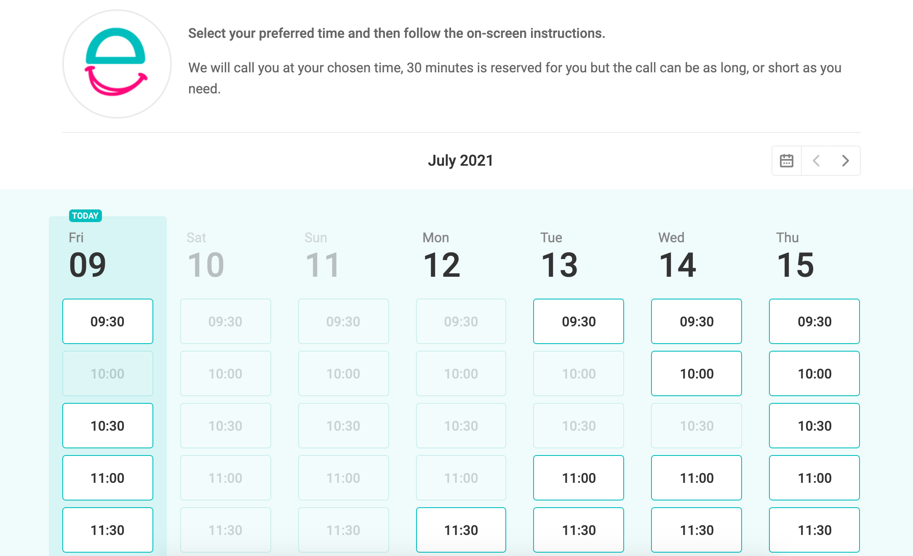
Your free 121 support
https://easyfundraisingcoaches.youcanbook.me/

Slide 9
Boparan Charitable Trust

Slide 10
How to raise as much as possible this Christmas

Slide 11
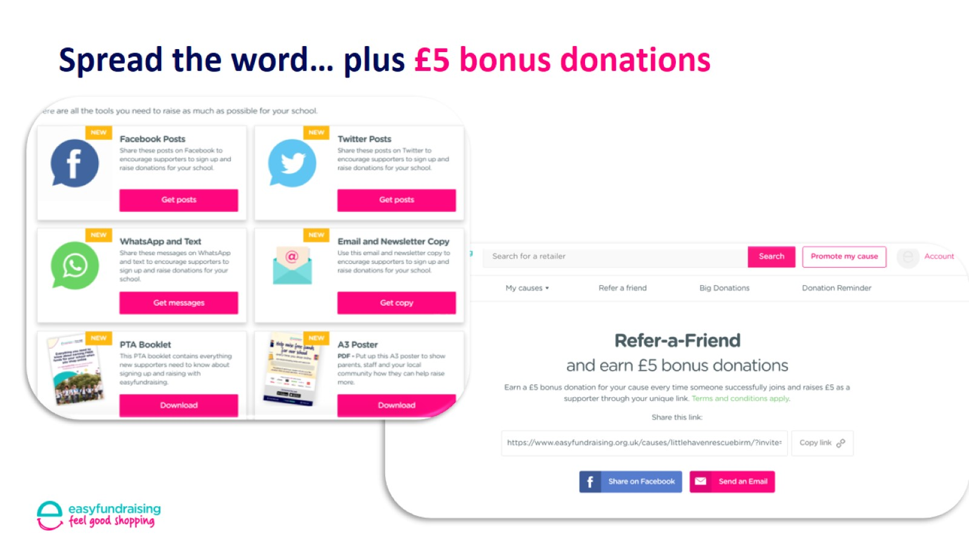
Spread the word… plus £5 bonus donations

Slide 12
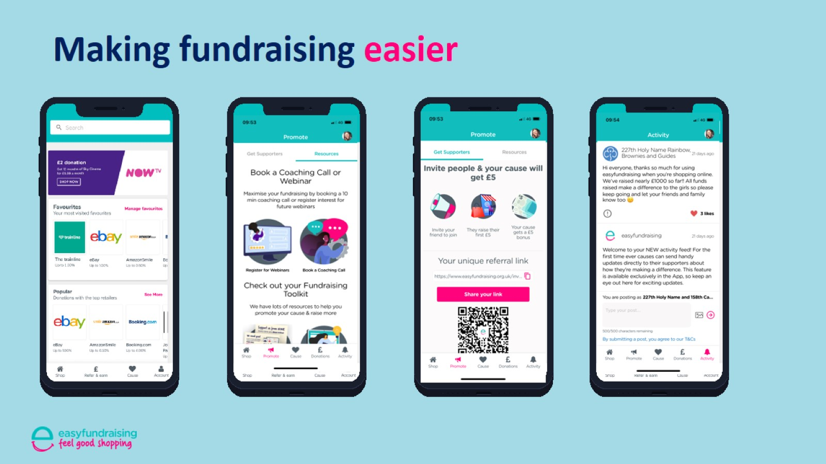
Making fundraising easier

Slide 13
Never miss a donation

Slide 14
Festive fun to engage your supporters

Slide 15
£100 donation competition
Register to enter here:
www.easyfundraising.org.uk/lcvs

