Slide 1
Sustainability and Investment in Social Prescribing Tuesday 7th May 2019 Manchester
Primary care networks and Social Prescribing – a national perspective
Susanne Cox, Manager, Personalised Care, NHS England
susanne.cox1@nhs.net

Slide 2
Personalised Care & Social Prescribing in the NHS Long Term Plan

Slide 3
Long-term plan: 5 major practical changes to the service model
We will boost ‘out-of-hospital’ care, and finally dissolve the historic divide between primary and community health services.
The NHS will redesign and reduce pressure on emergency hospital services.
People will get more control over their own health, and more personalised care when they need it.
Digitally-enabled primary and outpatient care will go mainstream across the NHS.
Local NHS organisations will increasingly focus on population health and local partnerships with local authority-funded services, through new Integrated Care Systems (ICSs) everywhere.

Slide 4
Long Term Plan commitments
1.39. We will roll out the NHS Personalised Care model across the country, reaching 2.5 million people by 2023/24 and then aiming to double that again within a decade.
1.40. As part of this work, through social prescribing the range of support available to people will widen, diversify and become accessible across the country. Link workers within primary care networks will work with people to develop tailored plans and connect them to local groups and support services. Over 1,000 trained social prescribing link workers will be in place by the end of 2020/21 rising further by 2023/24, with the aim that over 900,000 people are able to be referred to social prescribing schemes by then.

Slide 5
A new primary care workforce
5 additional reimbursable roles:
clinical pharmacists
social prescribing link workers
physician associates
first contact physiotherapists
first contact community paramedics
“By 2024 [all the above roles] will have become an integral part of the core general practice model throughout England – not just ‘wrap around’ support that could instead be redeployed at the discretion of other organisations.”
Five Year Framework for GP Contract Reform

Slide 6
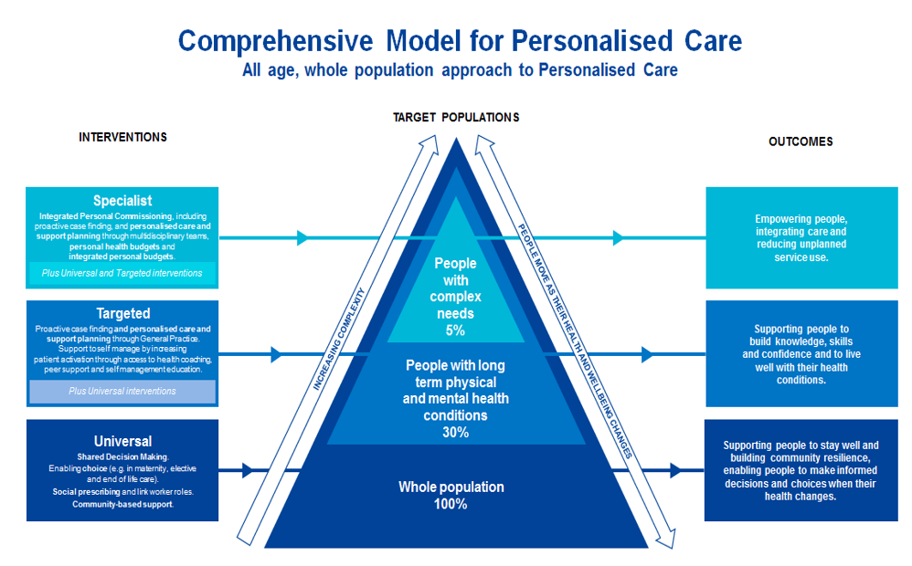
This means a, comprehensive whole population approach:

Slide 8
Five Year Framework for GP Contract Reform
NHS England will provide funding directly to primary care networks for a new, additional social prescribing link worker to be embedded within every primary care network multi-disciplinary team, through the Network Contract Direct Enhanced Service (DES).
Starting from July 2019, at 100% reimbursement of the actual on-going salary costs, up to a maximum amount (£34,113) GP Contract Reform, section 1.26. The percentage will neither taper nor increase during the next five years, giving networks maximum confidence to recruit to the full.
Existing practice suggests that many primary care networks may choose to fund a local voluntary sector organisation to employ the link workers on behalf of the network. The contractual arrangement will be for local areas to decide, but the funding will be routed via the Network Contract DES.
Funding will also be available to all primary care networks across England, including local areas where link workers are already embedded in primary care multi-disciplinary teams.

Slide 9
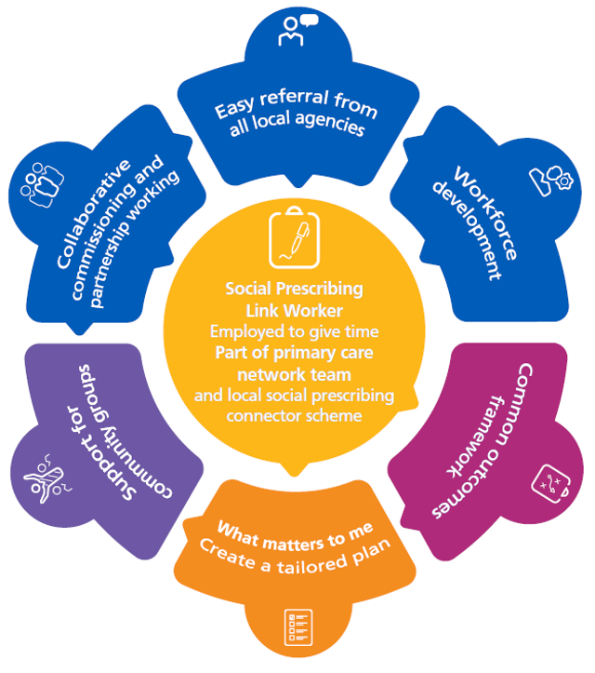
Key elements of social prescribing in Primary Care Networks

Slide 10
Link workers in Primary Care Networks
Social prescribing link workers will be embedded within primary care network multi-disciplinary teams to:
provide personalised support to individuals, their families and carers to take control of their wellbeing, live independently, and improve their health outcomes
develop trusting relationships by giving people time and focusing on ‘what matters to them’
take a holistic approach, based on the person’s priorities, and the wider determinants of health
co-produce a simple personalised care and support plan to improve health and wellbeing
introduce or reconnect people to community groups and services
evaluate the individual impact of a person’s wellness progress
record referrals within GP clinical systems using the national SNOMED social prescribing codes
support the delivery of the comprehensive model of personalised care
draw on and increase the strengths and capacities of local communities, enabling local VCSE organisations and community groups to receive social prescribing referrals.

Slide 11
How can local partners maximise this funding opportunity?
CCGs will be encouraged to bring local partners together to develop a shared local plan for social prescribing (by June 2019), including local authorities, primary care networks, VCSE leaders, existing social prescribing connector schemes and other partners.
Plans should include:
How partners will build on existing local social prescribing connector schemes to avoid duplication and maximise impact
How social prescribing link workers will be embedded in all primary care networks across the local area
How additional link workers will be recruited locally
Shared commitment to support for the VCSE sector and community groups to receive social prescribing referrals, through funding and development support.
Templates are available from NHS England: england.socialprescribing@nhs.net

Slide 12
NHS England publications:
Summary Guide to Social Prescribing
Universal Personalised Care
NHS Long Term Plan
Five Year Framework for GP Contract Reform
Network Contract DES specification 2019/20
NHS England has set up an online learning platform to share the latest resources. To join the platform, please contact england.socialprescribing@nhs.net

Slide 13
Social Prescribing in GM
Giles Wilmore: Associate Lead, People & Communities, Greater Manchester Health & Social Care Partnership

Slide 14
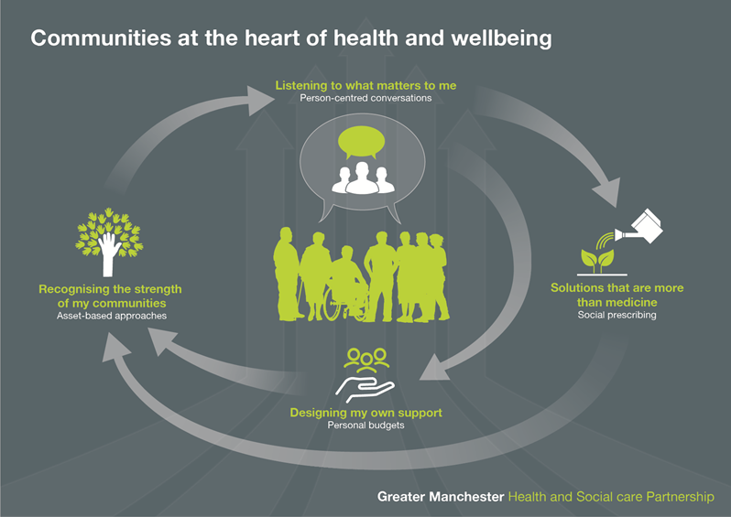

Slide 15
Activity in 2018/19
 |  | 2018/19 Q4
 | Personalised care and support plans | 13,539 ¹
 | Social prescribing | 7,369 ²
 | Personal health budgets and integrated personal budgets | 2,199
 | Asset based approaches | n/a ³
Provisional data as at 30/04/19
Notes
Data from three localities, some for part-year, and includes some cross-GM plans
Data from six localities, some for part-year
To be collected from 2019/20

Slide 16
Activity metrics – 2019/20
Person-centred conversations
(plans and conversations)
Social prescribing
(referrals, take-up, GP practices, link workers)
Personal budgets
(data taken from the national collection exercise)
Asset based approaches
(levels of expenditure and number of groups)
Self-management and self-care
(referrals and levels of activation)

Slide 17
Outcomes and impact
There are people in my life who
matter to me
I can live the life I want, not just get by
I am in control of decisions that matter to me
I feel safe with the people in my life
I spend time doing things that are meaningful to me
I know what makes me feel better
I am respected for being who I am
I can achieve my full potential
I can get help if I need it

Slide 18
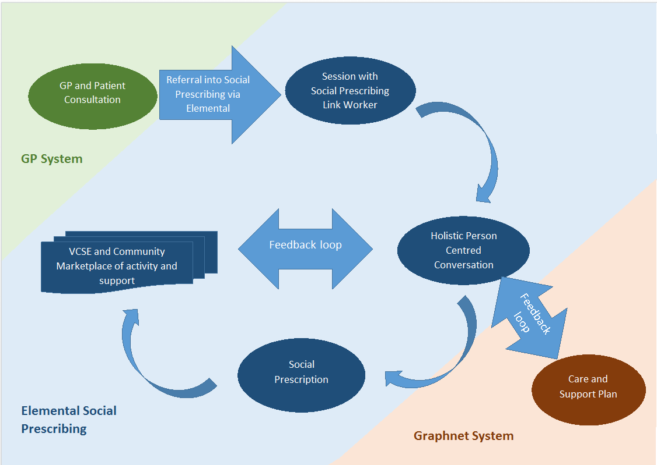
Capturing activity and impact

Slide 19
How do we use PCN funding to build on these achievements to date?
GM H&SCP is working with CCGs, local authorities, primary care, VCSE leaders, existing social prescribing connector schemes and other partners across wider public service in all ten GM localities to help to ensure the new PCN funding builds on our hard work to date.
This aim is for each locality to reach agreement about:
how partners will use new NHSE funding to build on existing local social prescribing connector schemes to avoid duplication and maximise impact;
shared commitment to support for the VCSE sector and community groups to receive social prescribing referrals, through funding and development support;
how social prescribing link workers are recruited, trained, supported and developed, including how their role differs from high impact changes - care navigation and active signposting.

Slide 20
Contact us
Giles Wilmore | Associate Lead: People & Communities
Greater Manchester Health & Social Care Partnership
07792 663923
giles.wilmore1@nhs.net
Sophie Glinka | Social Prescribing Lead
Greater Manchester Health & Social Care Partnership
07746852134
Sophie.glinka@nhs.net

