Slide 1

Community Wellbeing Toolkit
Feeling Safe,
Taking Care of Yourself, and Getting Support.

Slide 2
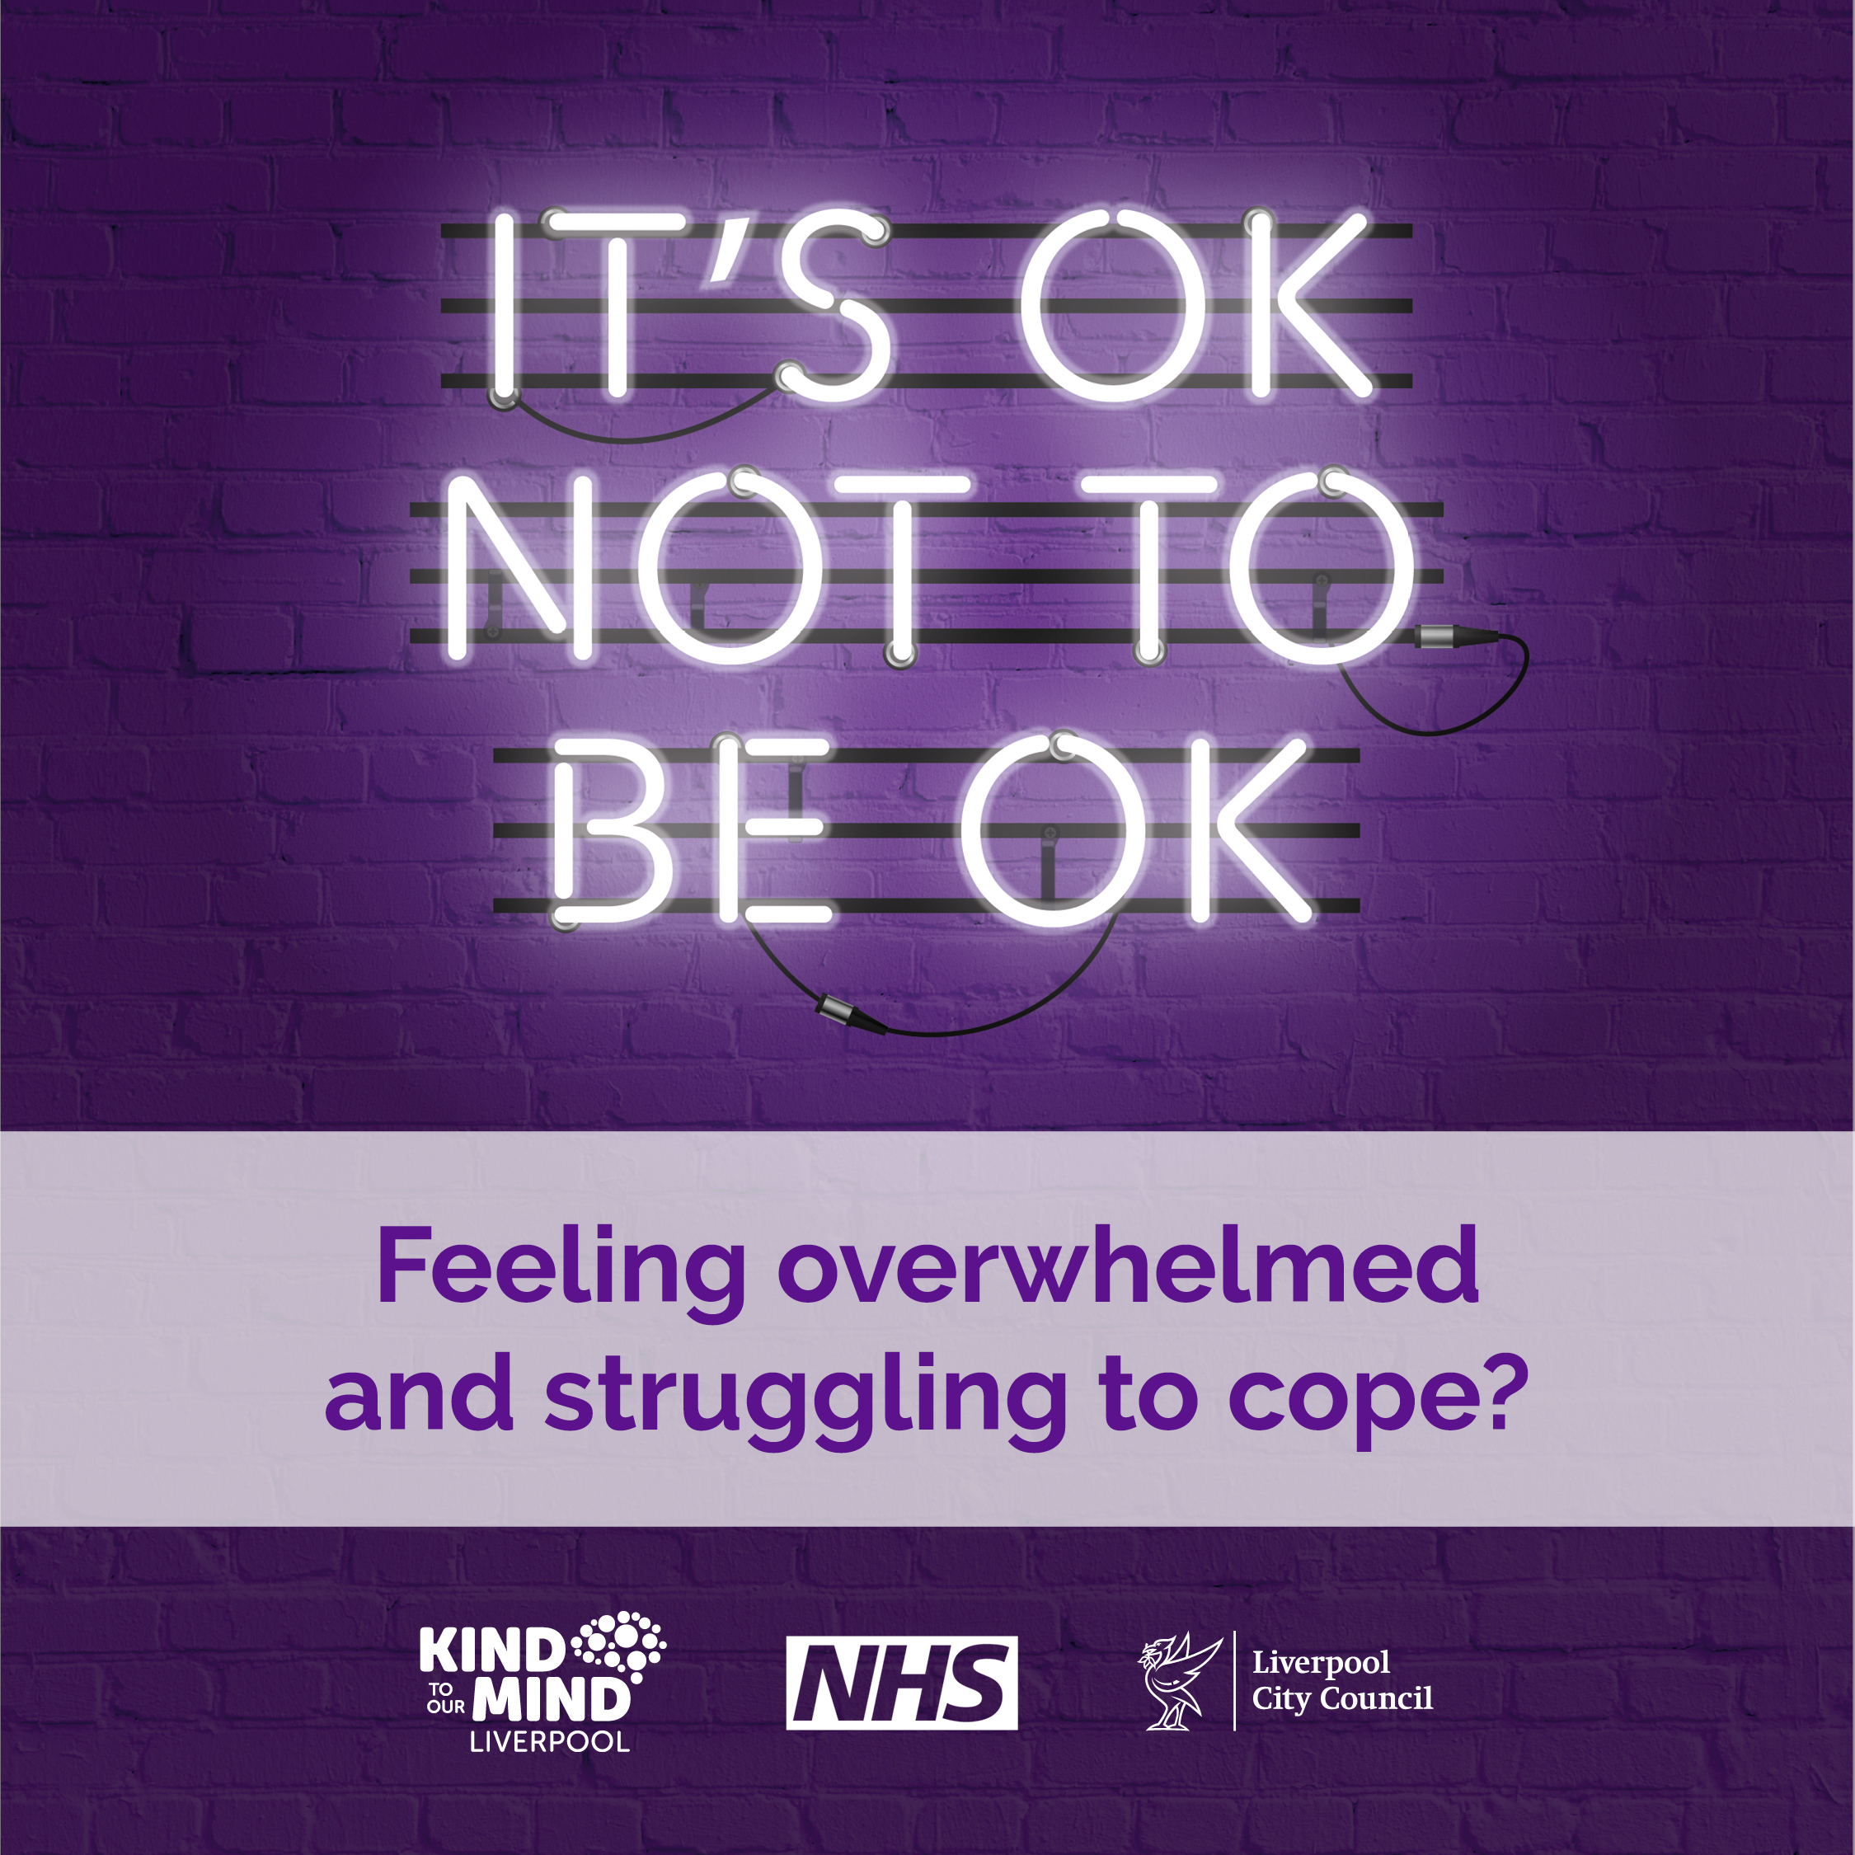
Difficult or Traumatic Events
Everyone reacts differently to tough or traumatic experiences. Seeing or hearing about conflict or violence can be really upsetting, and for some, it can be pretty overwhelming.
After something really upsetting happens, you might experience:
Bad dreams, flashbacks, or thoughts you can’t shake.
Strong emotions like worry, fear, anger, guilt, or shame.
Negative thoughts about yourself or others, like blaming yourself.
Acting differently, maybe avoiding going out or not enjoying things you used to.
Changes in how you connect with others, like feeling distant or on guard.
These feelings and symptoms are often temporary but sometimes they persist and impact mental health. It’s important to remember, help is out there if you need it.

Slide 3
Ways to start feeling better
Give yourself time…
Friends, family, or anyone you trust can help you feel better. Being around people who care about you helps you feel protected and supported.
Stick to your routine…
Keep doing your usual activities, even if it feels tough. It can help bring some normality back into your life.
Talking to someone you trust about what happened and how you’re feeling can be a big relief. It might even help them too if they’re going through something similar. Listening to how someone feels can make a big difference.
Lean on your support around you…
Overcoming these thoughts and feelings can take time, so don’t put yourself under too much pressure to feel better straight away.
Talk about it…
They can offer emotional support, help with practical tasks or just spending time doing normal things - all help improve our mood.
Take care of yourself
  Eating well, staying active, and getting enough sleep are all part of self-care and are essential to mental health and wellbeing.

Slide 4
When to get help
Everyone heals differently, and many people recover with support from those around them.
But if you notice that you or someone you know isn’t getting better, here are some signs that more help might be needed:
Feeling the same or worse over time?
If you’ve been feeling really bad for more than a few weeks and it’s not getting better, it might be time to reach out for help.
Feeling down all the time?
If you’re feeling sad or anxious most days, or if you’re having trouble sleeping or thinking clearly, it’s okay to ask for help.
Lost interest in things?
If you’re not into the things you usually enjoy, consider reaching out for support.
Feeling overwhelmed?
If you ever feel like you just can’t handle things, it’s important to get some help as soon as possible.

Slide 5
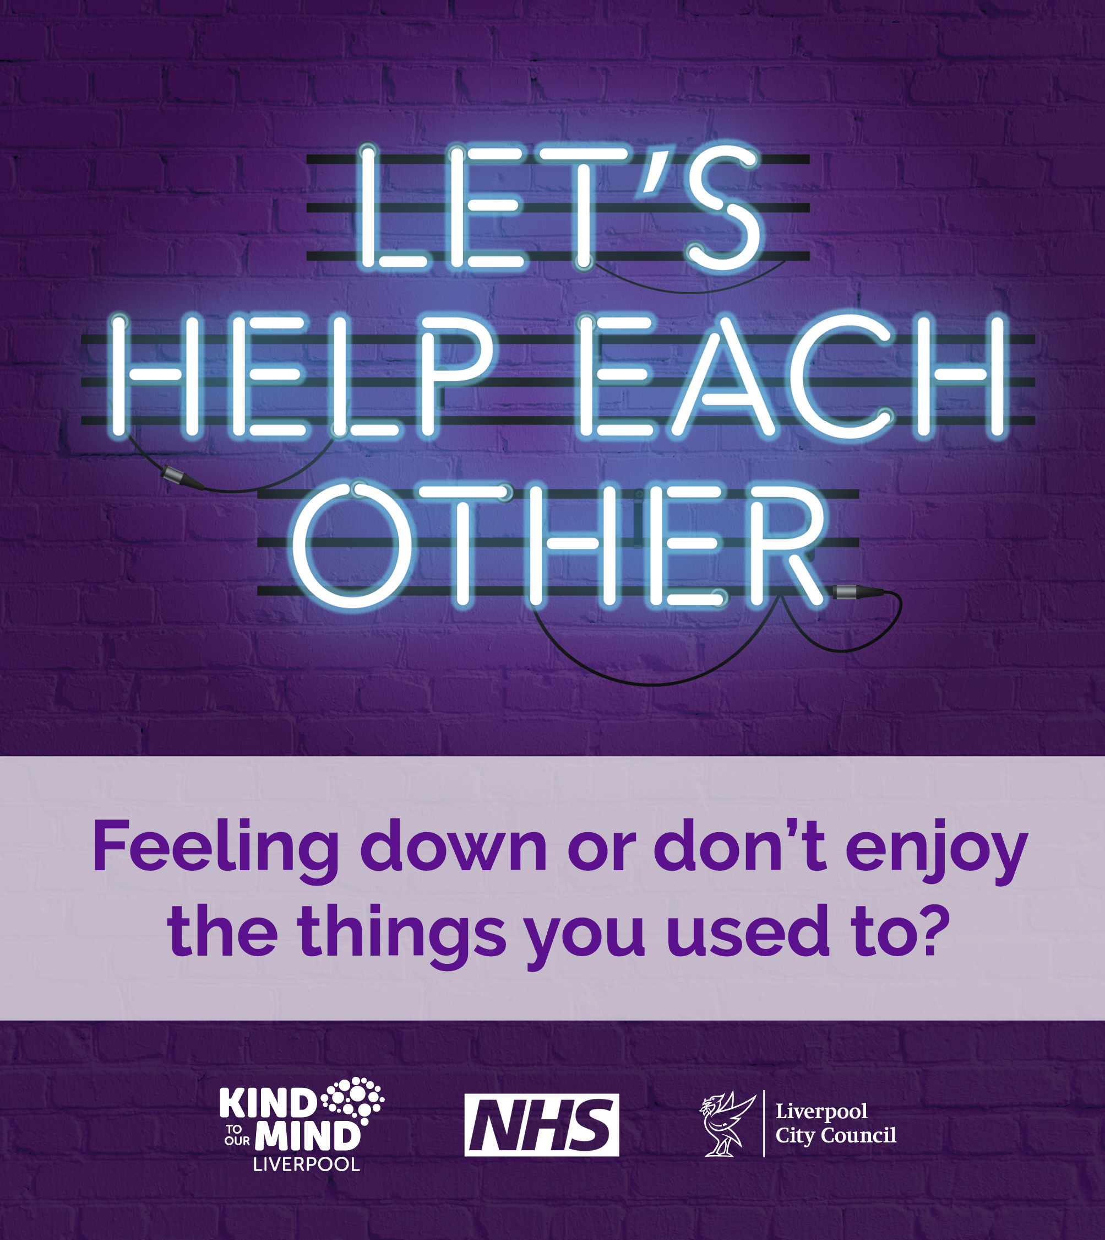
How can you help someone?
If you’re worried about someone, here’s how you can support them:
Be there – offer to spend time and let them know you’re there for them, even if they’re not ready to talk.
Listen – if they do want to talk, just listen. You don’t have to give advice—just being there and hearing them out can mean a lot.
Ask how you can help – ask if they need help finding extra support or with practical things like chores or running errands.
Ask the hard questions - if you’re really worried, don’t be afraid to ask if they’re self-harming or thinking about suicide.
It’s important to know so you can help them get the right support.
Visit Reach Out Liverpool for more.

Slide 6
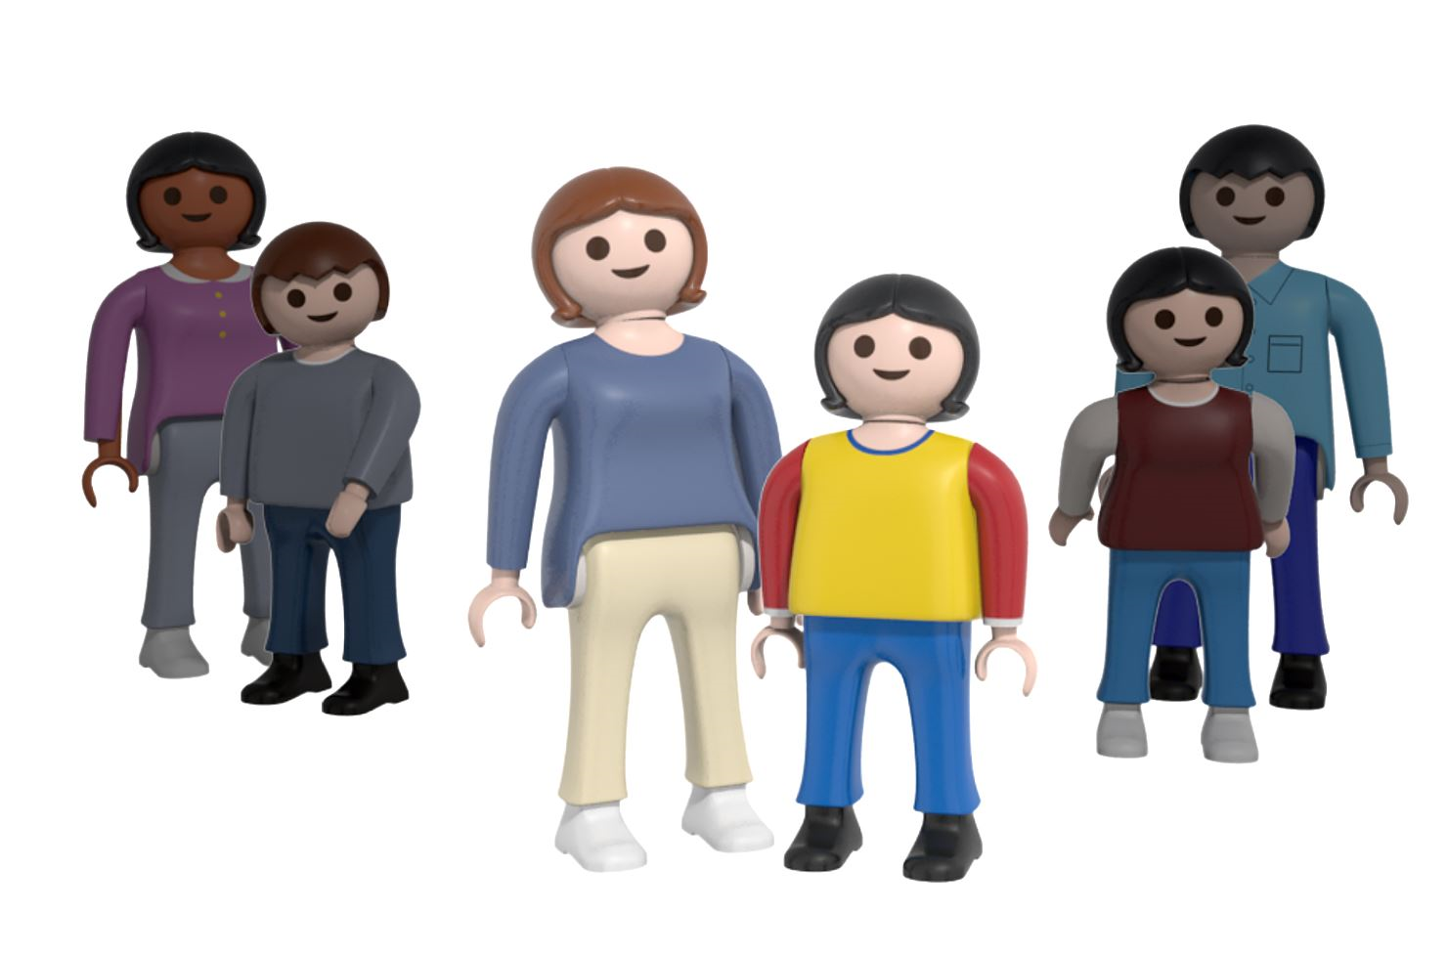


We're here for you, if you need to talk to someone...
Liverpool's mental health services are here to help when children and young people need support with their emotional wellbeing and mental health.
The Liverpool Crisis Care team provides support, advice and guidance to children, young people and their families needing urgent help, 24/7.
CALL 111 and select the mental health option
(Adults and people outside of Liverpool can use the same number to get urgent help)
Shout 85258 is a free, confidential, 24/7 text message support service for anyone who feels overwhelmed or is struggling to cope.
The service is staffed by trained volunteers who will help you take your next steps towards feeling better. They can help with issues such as stress, anxiety, and depression and are here to talk at any time of day or night. TEXT ‘SHOUT’ to 8525

Slide 7



We're here for you, if you need to talk to someone...
YPAS Walk-In Support Hub (WISH) provides same-day mental health support for children, young people, and families in Merseyside.
Their practitioners can support children, young people, and families with emotional wellbeing needs and advise on various practical support issues. They provide information, advice, and guidance.
YPAS Central Hub address:
36 Bolton Street
Liverpool
L3 5LX
The Hub is open Monday - Wednesday 9.30am -8pm Thursday: 2pm - 8pm and Friday: 9.30am - 4pm, you don’t need an appointment, just turn up.
Kooth provide safe, anonymous online support for young people aged 10-25.
Visit Kooth.com

